Slide 1

Client Servicing Management System

Slide 2
Descriptive Information
Services
Private Limited Company Registration
Register a One person company
Start a Limited Liability Partnership
Employee
Dhrubo
Sharanya
Vinod
Kumar
Milestone
Document Preparation
Form Verification
Form Upload
Company Incorporated
Ticket
Ticket Activity
Notes:
1)Kumar was not allocated any Ticket
2)One Service could be mapped to many employees
3)One employee could be mapped to many milestone activity
4)Activity allocation starts at 10: 00 in the morning & continues till 18:00
5)All Ticket generation has happened for 1- Nov to 5-Nov
6)5 Tickets were generated all were on 1 st Nov

Slide 3
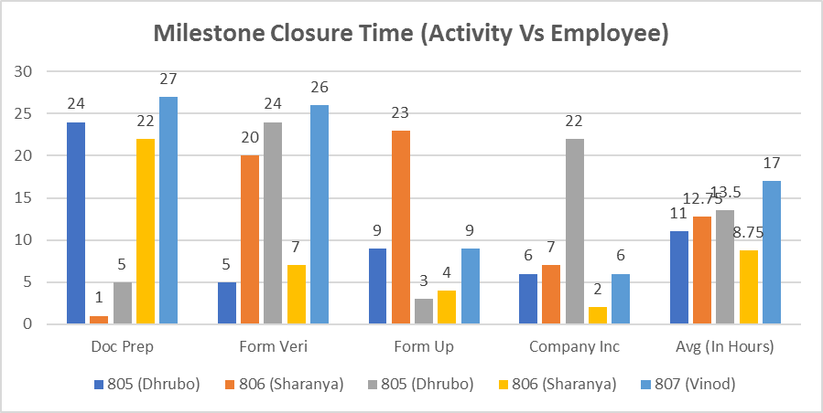
Milestone Closure Time
Notes:
The Fastest Ticket closure was made by employee - Sharanya
(1 Hr for Document Preparation)
The Slowest Ticket closure was made by employee – Vinod
(27 Hr for Document Preparation)

Slide 4
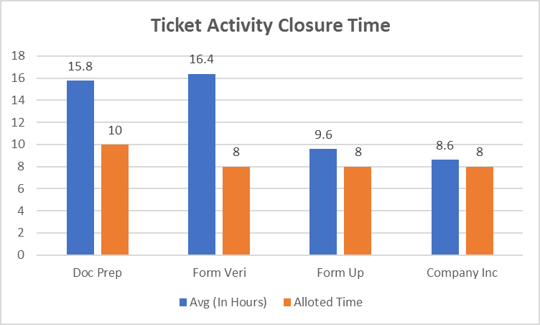
Average Time
Notes:
Milestone Wise – Time taken for closure
(Form Verification > Document Preparation >Form upload > Company Incorporated )
Form verification takes considerably longer time for closure

Slide 5
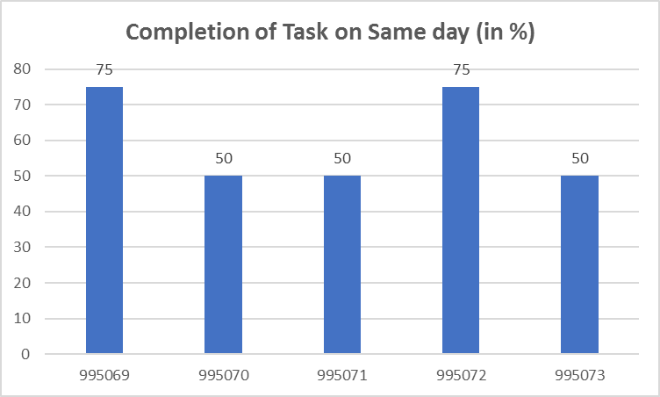
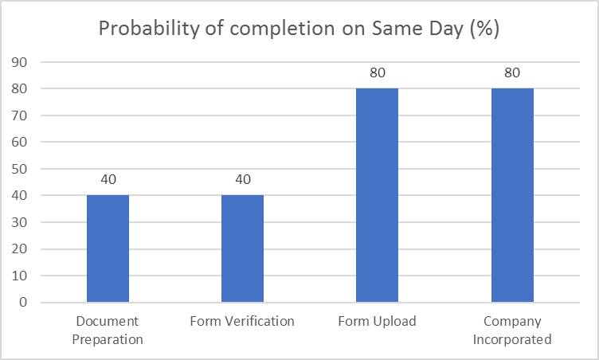
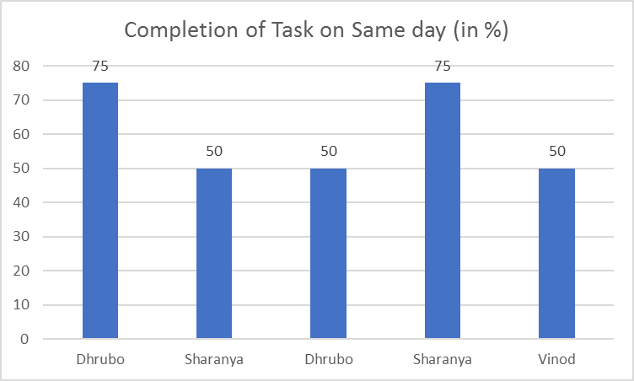
Reliable Employee
Notes:
In each ticket, 4 milestones were allocated.
With respect to employee completed on same Day
Dhrubo completed 3 out of 4 milestones on the same day for Ticket 69
75% of the times he has completed the milestone on the same day itself
With respect to milestone completed on Same Day
Form Upload & Company Incorporated can be completed sooner
Ie There is 80% chance that they can be completed on the same day

Slide 6
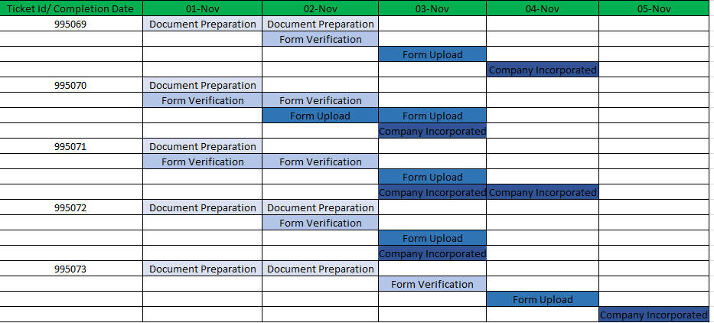
GANTT CHART

Slide 7
Reference Tables
ID/Milestones | Doc Prep | Form Veri | Form Up | Company Inc | Avg (In Hours)
805 (Dhrubo) | 24 | 5 | 9 | 6 | 11
806 (Sharanya) | 1 | 20 | 23 | 7 | 12.75
805 (Dhrubo) | 5 | 24 | 3 | 22 | 13.5
806 (Sharanya) | 22 | 7 | 4 | 2 | 8.75
807 (Vinod) | 27 | 26 | 9 | 6 | 17
Avg (In Hours) | 15.8 | 16.4 | 9.6 | 8.6
Alloted Time | 10 | 8 | 8 | 8
ID/Ticket | 995069 | 995070 | 995071 | 995072 | 995073
Completion of Task on Same day (in %) | 3/4*100 | 2/4*100 | 2/4*100 | 3/4*100 | 2/4*100
Employee Name | Dhrubo | Sharanya | Dhrubo | Sharanya | Vinod
Completion of Task on Same day (in %) | 75 | 50 | 50 | 75 | 50
Milestone Activity | No of Task on Same Day | %
Document Preparation | 2 | 40
Form Verification | 2 | 40
Form Upload | 4 | 80
Company Incorporated | 4 | 80

